Slide 1
Theory and Evidence Why we do what we do
David Taylor
dcmt@liv.ac.uk
http://www.liv.ac.uk/~dcmt

Slide 2
Students as peer-teachers/mentors
What is the point…
…of medical school?
…of being a peer-teacher or mentor?

Slide 3
What is the outcome?
Kirkpatrick

Slide 4
How will we know?
Bloom

Slide 5
Which of the outcomes do you find hardest yourself
A
B
C
D
E
F

Slide 6
Which do you find hardest to help others do?
A
B
C
D
E
F

Slide 7
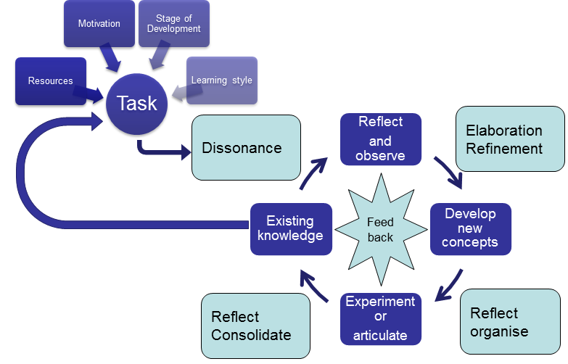
How people learn
Taylor and Hamdy 2013

